Slide 1
Introduction to Machine Learning
By Dr. Ali Saeed

Slide 2
Lecture Outline
What is Preprocessing
Preprocessing on text
Preprocessing on Images

Slide 3
Preprocessing
Data preprocessing is a process of preparing the raw data and making it suitable for a machine learning model.
It is the first and crucial step while creating a machine learning model.
When creating a machine learning project, it is not always a case that we come across the clean and formatted data.

Slide 4
Preprocessing on Text
Text preprocessing is a method to clean the text data and make it ready to feed data to the model. Text data contains noise in various forms like emotions, punctuation, text in a different case.
  Tokenizer
    Word Tokenizer
    Sentence Tokenizer
  Change text to lower case
  Remove punctuation marks
  Stop words removal
  Stemmer

Slide 5
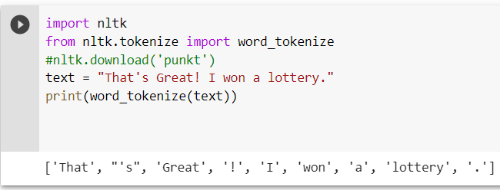
Word Tokenizer
It divides a paragraph into word tokens:

Slide 6
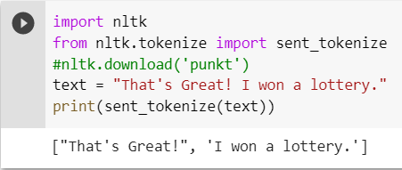
Sentence Tokenizer
It divides a paragraph into sentence tokens:

Slide 7
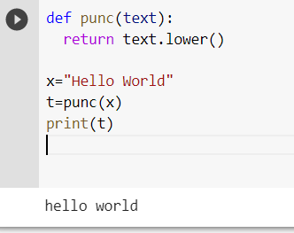
Convert text to lower text
Convert the text into a lower case

Slide 8
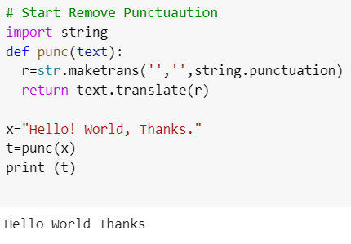
Remove of Punctuation
Remove punctuation marks from the given text
The maketrans() method returns a mapping table that can be used with the translate() method to replace specified characters.
maketrans(x,y,z) → Z means what you want to remove from string

Slide 9
Stop Words
These are commonly occurring words and we usually remove it from the text
Example
  I, we, he, it, in, the etc.

Slide 10
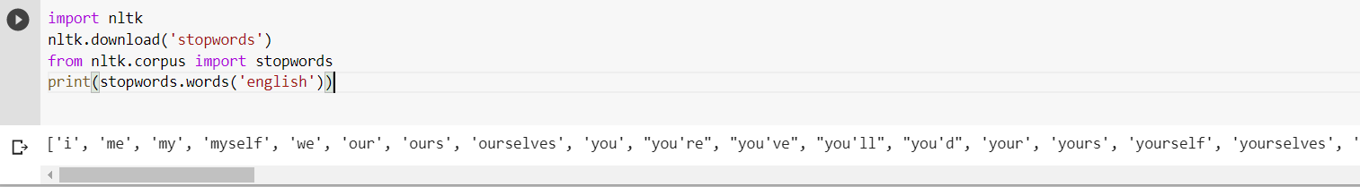
List of English Stop words
Once you need to use statement nltk.download(‘stopwords’)

Slide 11
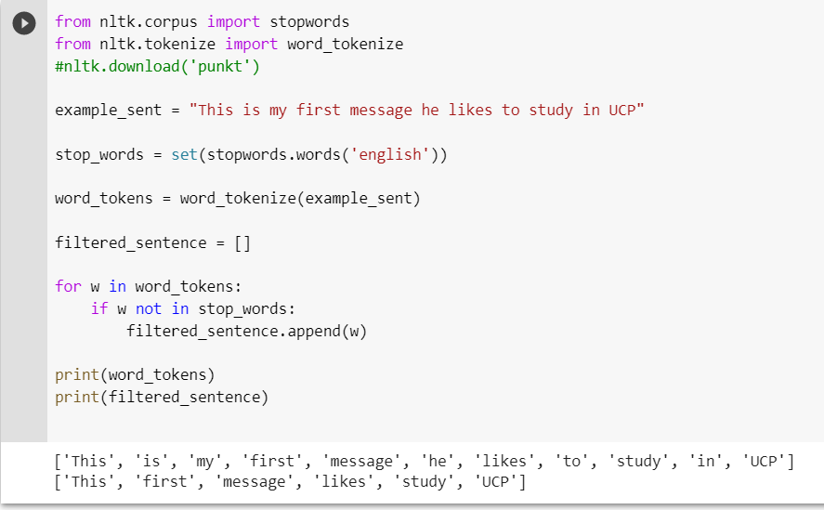
Stop Words Removal

Slide 12
Stemming and Lemmatization
Both are closely related to find the root word
Stemming identifies the common root form of a word by removing or replacing word suffixes
Lemmatization is the process of converting a word to its base form. The difference between stemming and lemmatization is, lemmatization considers the context and converts the word to its meaningful base form, whereas stemming just removes the last few characters, often leading to incorrect meanings and spelling errors.

Slide 13
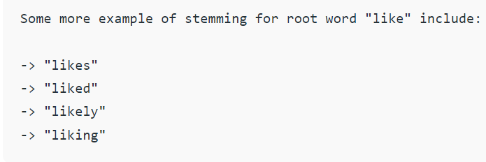
Stemmer

Slide 14
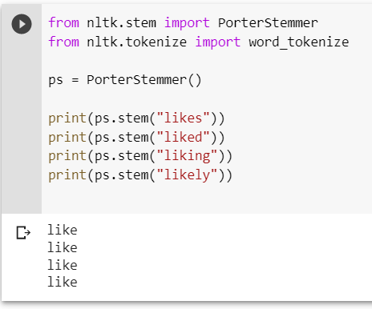
Stemming using Poster Stemmer

Slide 15
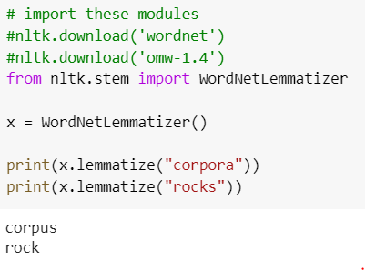
Lemmatization
Lemmatization is the process of converting a word to its base form

Slide 16
Image Preprocessing
Grayscale Conversion
Black and White Conversion

Slide 17
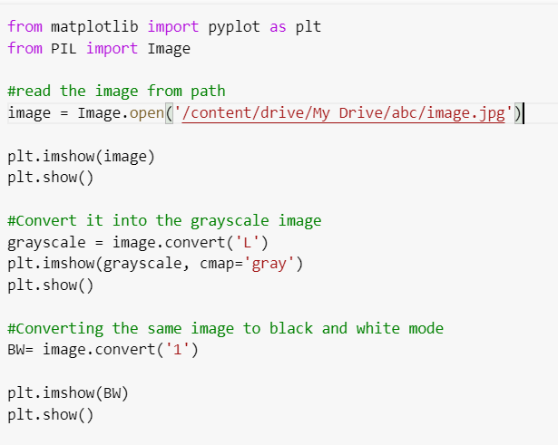
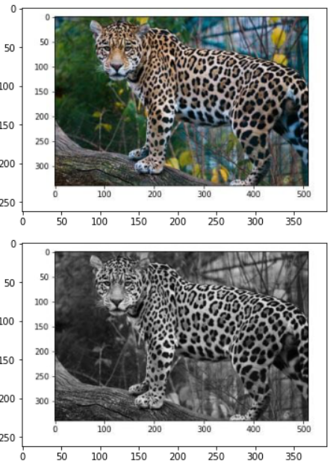
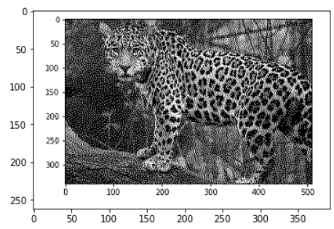
Python code for image conversion
Output
imshow() method is used to display an image in a window. The window automatically fits to the image size.

